Slide 1
Journal Modes in SQLite
오기환
(wurikiji@gmail.com)
SKKU VLDB Lab. (27334)

Slide 2
Contents
Atomic Commit in SQLite
Rollback Journal
WAL Journal

Slide 3
Atomic commit in SQLite

Slide 4
Atomic Commit in SQLite
Atomic commit means all or nothing
Some assumptions
A sector write is not atomic
OS will buffer writes and reorder the writes
flush or fsync data
File deletion is atomic
Bit error is the responsibility of the hardware

Slide 5
Roll back journal

Slide 6
RBJ
Rollback Journal (RBJ)
Old page images are backed up in RBJ file for undo
RBJ file should be deleted at commit time
Transaction commit is regarded as success only after RBJ file is deleted
RAM
P1_old
P2_old
Transaction Commit
P1_new
P2_new
before Update
fsync() DB file
2 fsync()s RBJ file
Storage
P1_old
P2_old
Journal file is deleted
RBJ file (per TX)
Notes:
Now I will explain two journal modes of SQLite.
First Rollback journal mode.
If a transaction updates pages in rollback journal mode,
the original content of the page is copied to the rollback journal before updating it in the database, so that the change can always be undone if the transaction aborts.
When transaction commits, SQLite syncs rollback journal file first,
then flushes updated pages to original database file.
Original database file is also required to sync before commit.
Rollback journal file should be deleted at commit time.
In addition, A transaction commit is regarded as success only after journal file is deleted.
there are some run-time overheads in rollback journal mode:
It is described in right figure.
First a journal file is created and deleted whenever a new transaction begins and ends.
Second, it invokes 3 fsync operations per transaction, and it incurs 2 writes per each updated page.
According to recent study, one logical page update in SQLite which runs in rollback journal mode, may invoke 22 physical page writes in the worst case.

Slide 7
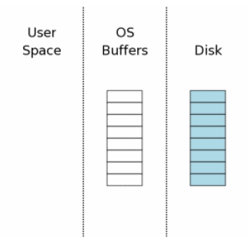
Single File Commit
Initial state
Rectangle: Page
Blue: Original
White: Empty

Slide 8
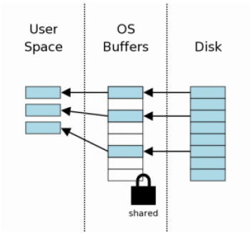
Single File Commit
Reading Data
Read 3 pages

Slide 9
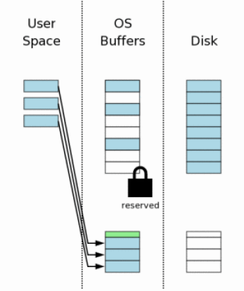
Single File Commit
Creating RBJ File
First create RBJ
Write original contents to RBJ file with pgno
Green: RBJ Header
Original size of DB

Slide 10
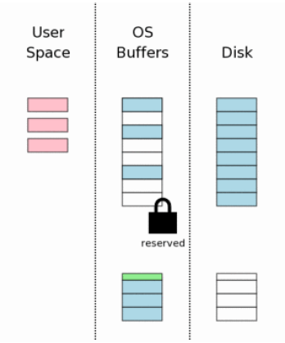
Single File Commit
Changing Data
Red: Modified Page

Slide 11
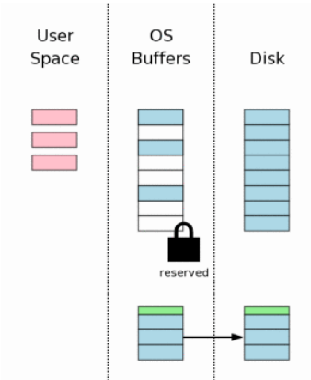
Single File Commit
Flushing RBJ
Flush RBJ to NV-storage
2 fsync() are required
First: flush content
Second: flush header
Avoid reorder issue

Slide 12
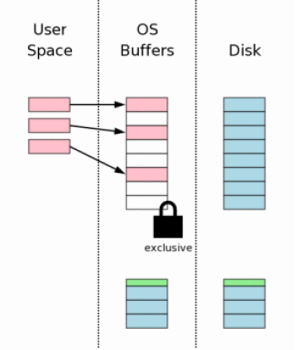
Single File Commit
Write Changes to DB
OS writes it to buffer

Slide 13
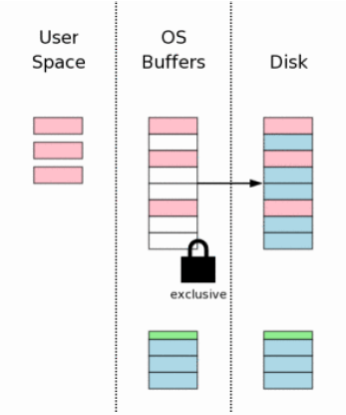
Single File Commit
Flush Changes
fsync() to DB file

Slide 14
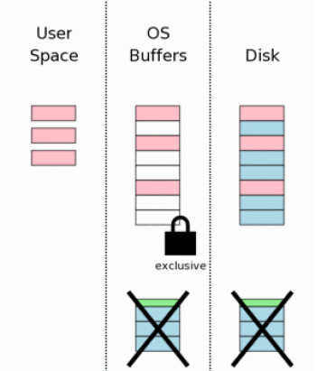
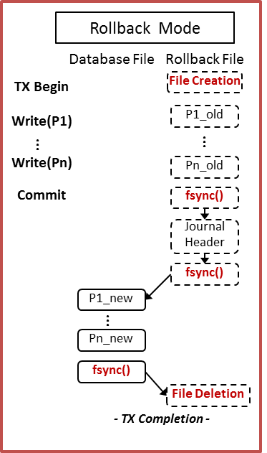
Single File Commit
Deleting RBJ File
Deleting file is exensive
3 methods to delete
Delete file
Truncate file size
Overwrite HDR with zero

Slide 15
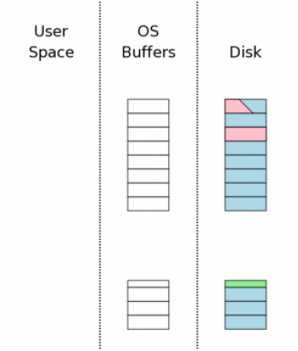
Roll back
Rollback partial changes
RBJ exists
RBJ is not empty
No write lock on DB
RBJ header is well-formed and not zeroed
No master journal name
Master journal exists with its name on RBJ

Slide 16
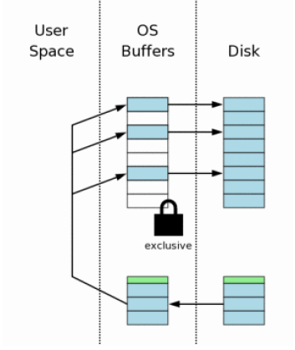
Roll back
Write content back to DB file
Use RBJ header info
Original DB size

Slide 17
Roll back
Deleting RBJ File
Deleting file is exensive
3 methods to delete
Delete file
Truncate file size
Overwrite HDR with zero

Slide 18
Multi-file Commit
SQLite allows a single database connection to talk to two or more database files
More complex than single file commit

Slide 19
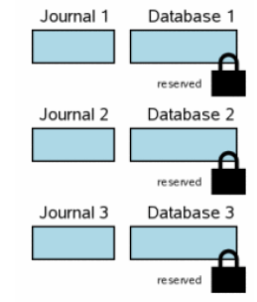
Multi-file Commit
Separate Rollback Journals for Each DB file

Slide 20
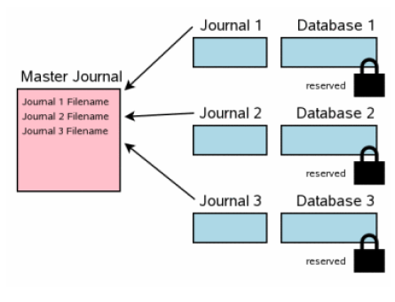
Multi-file Commit
The Master Journal File

Slide 21
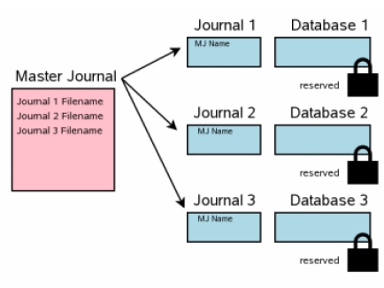
Multi-file Commit
Update RBJ headers
fsync() both before and after updating

Slide 22
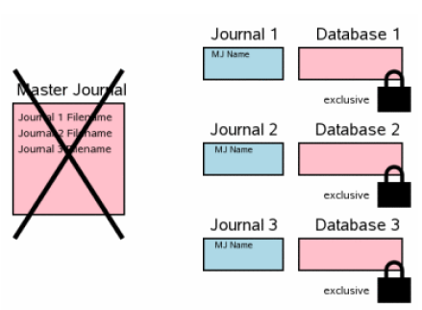
Multi-file Commit
Delete MJ file
No master journal name
Master journal exists with its name on RBJ

Slide 23
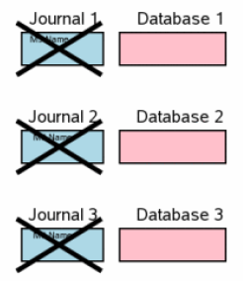
Multi-file Commit
Clean up the RBJ files

Slide 24
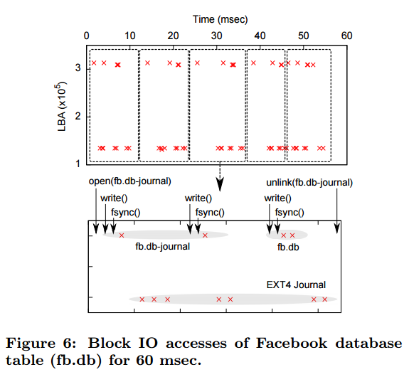
Problems of RBJ

Slide 25
WAL journal

Slide 26
Write-Ahead Logging - Advantages
WAL is significantly faster in most scenarios
Disk I/O operations tends to be more sequential using WAL
WAL uses many fewer fsync() operations

Slide 27
Write-Ahead Logging - Disadvantages
Not atomic across all databases as a set
WAL might be very slightly slower in read intensive applications
There is the extra operation of checkpointing

Slide 28
WAL
The original content is preserved in the database file
Changes are appended into a WAL file
Check-point when it becomes full
No file creation/deletion overhead
WAL Mode
Database File
WAL File
...
P1_new
...
RAM
Pn_new
P1_new
P2_new
Transaction Commit
P1_old
P2_old
fsync()
- TX Completion -
...
after Update
WAL File full
FULL
fsync() DB file
Check point
fsync() WAL file
Commit Done
Storage
P1
...
Checkpoint
P1_old
P2_old
P1_new
P2_new
Pn
fsync()
WAL file
28

Slide 29
Checkpointing
Moving the WAL file back into the database
By default, threshold size is 1000 pages

Slide 30
File Header

Slide 31
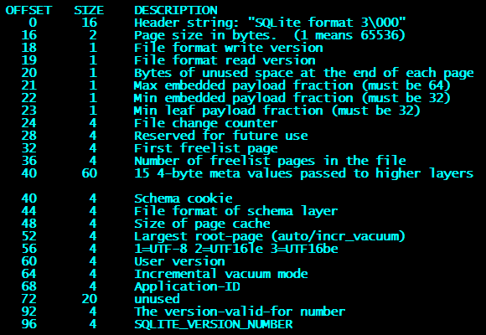
DB File Header
page size divided by 256

Slide 32
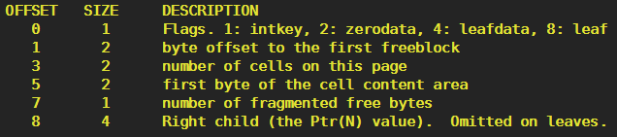
DB Page Header
For flags
0x02: Index b+tree internal node
0x0A: Index b+tree leaf node
0x05: Table B-tree internal node
0x0D: Table B-tree leaf node

Slide 33
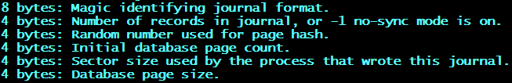
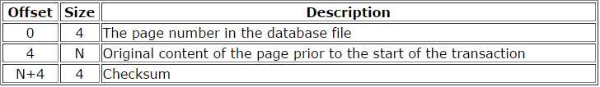
RBJ File Header
Journal Header
Journal record format

Slide 34
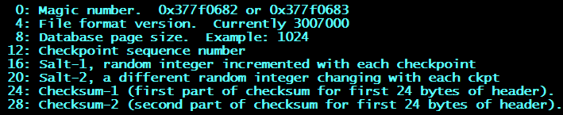
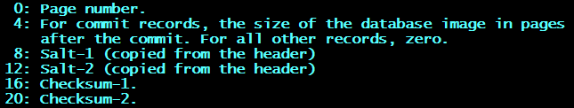
WAL File Header
WAL File Header
WAL Frame Header

Slide 35
Rollback journal internal
Example of transaction which inserts data

Slide 36
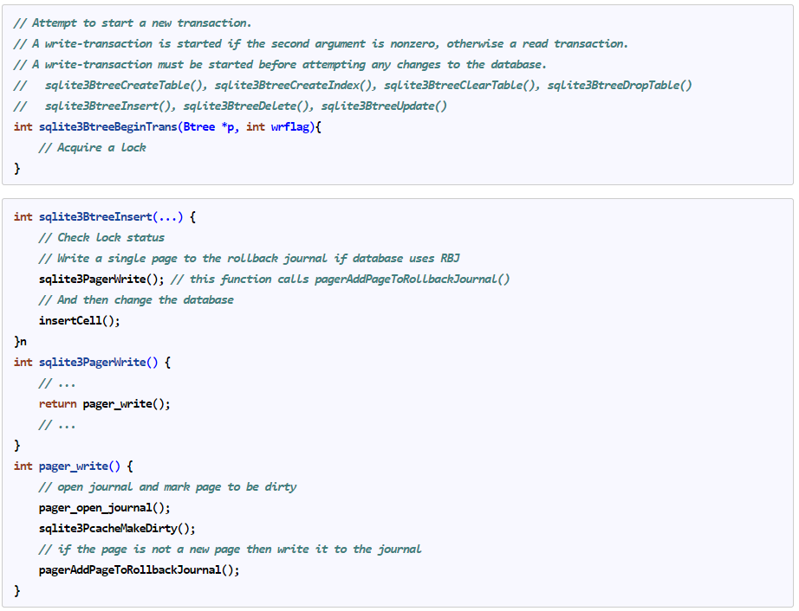
Start transaction and Insert

Slide 37
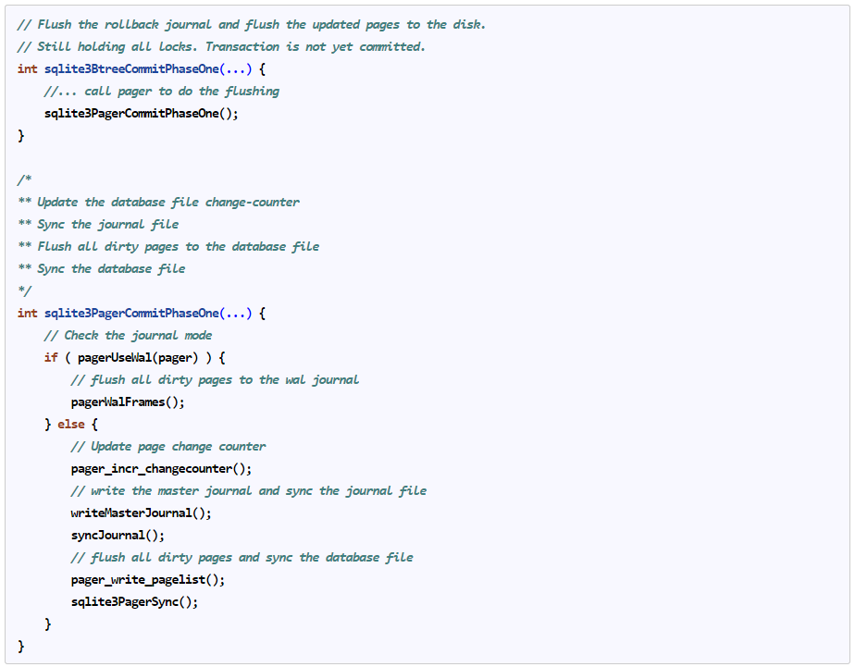
Commit Transaction – 1st phase

Slide 38
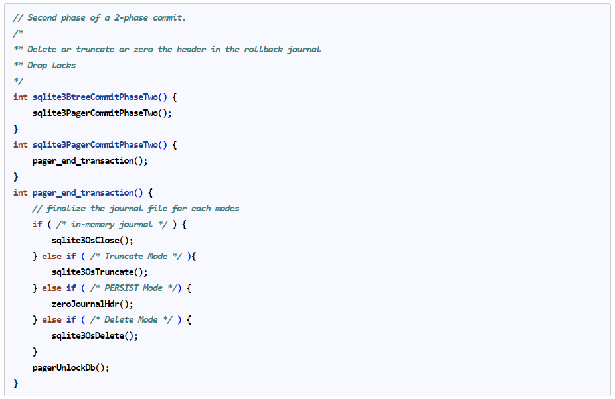
Commit Transaction - 2nd phase

Slide 39
References
www.sqlite.org
K. Lee et al., “Smart Layers and Dumb Result: IO Characterization of an Android-Based Smartphone”, EMSOFT’12
W. Kang et al., “X-FTL: Transactional FTL for SQLite Databases”, SIGMOD’13

